Slide 1
Histograms
CMPUT 206
Instructor: Nilanjan Ray
Source: http://www.imagingbook.com/

Slide 2
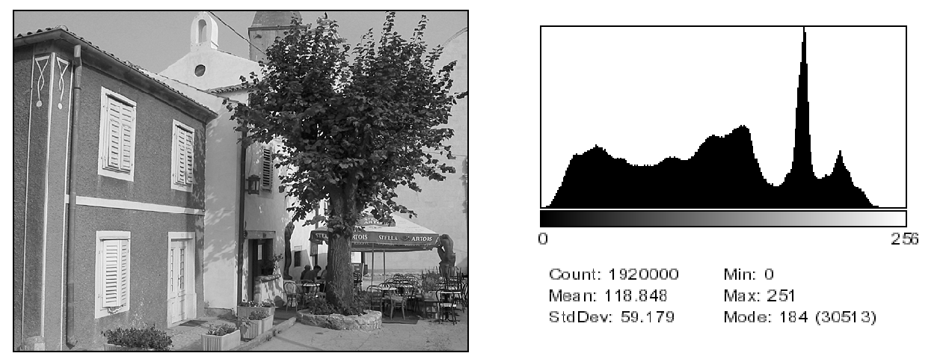
What is an image histogram

Slide 3
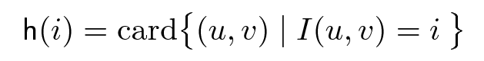
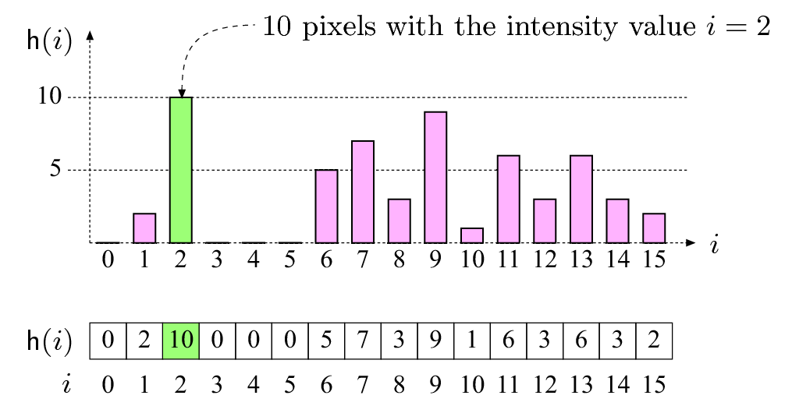
How to define a histogram
Or, formally,

Slide 4
Example: Histogram
Consider a 3-by-4 image with 8 gray levels
Its histogram h is as follows:
3 | 0 | 1 | 2
4 | 3 | 6 | 7
3 | 2 | 1 | 4
Gray level i | 0 | 1 | 2 | 3 | 4 | 5 | 6 | 7
Histogram h[i] | 1 | 2 | 2 | 3 | 2 | 0 | 1 | 1

Slide 5

Are histograms unique?
Three images with same histogram
Going from an image to its histogram, what information is lost?

Slide 6
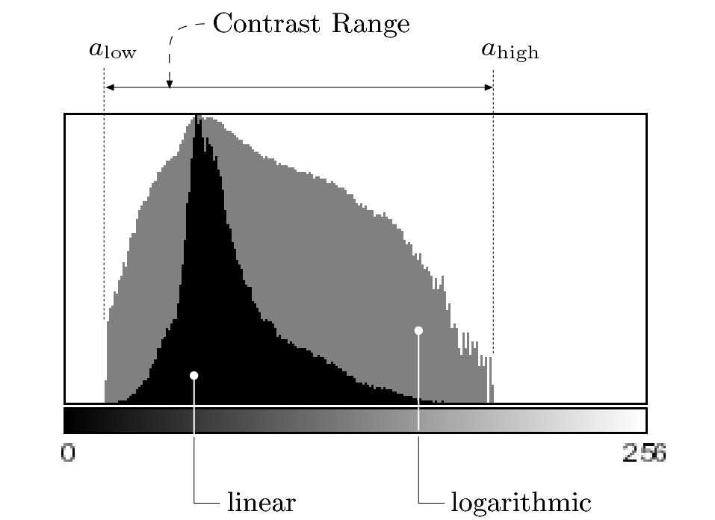
Histogram interpretation

Slide 7
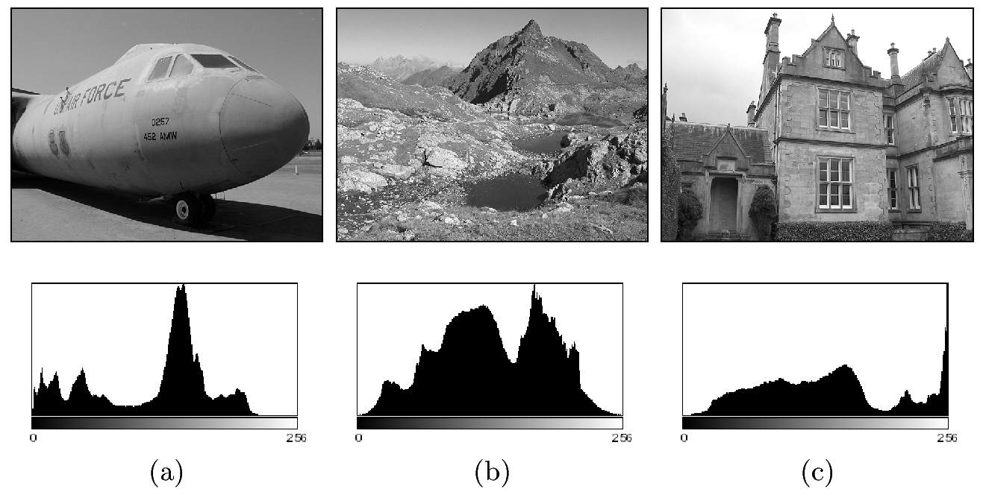
Exposure
Under exposed
Normal exposure
Over exposed

Slide 8
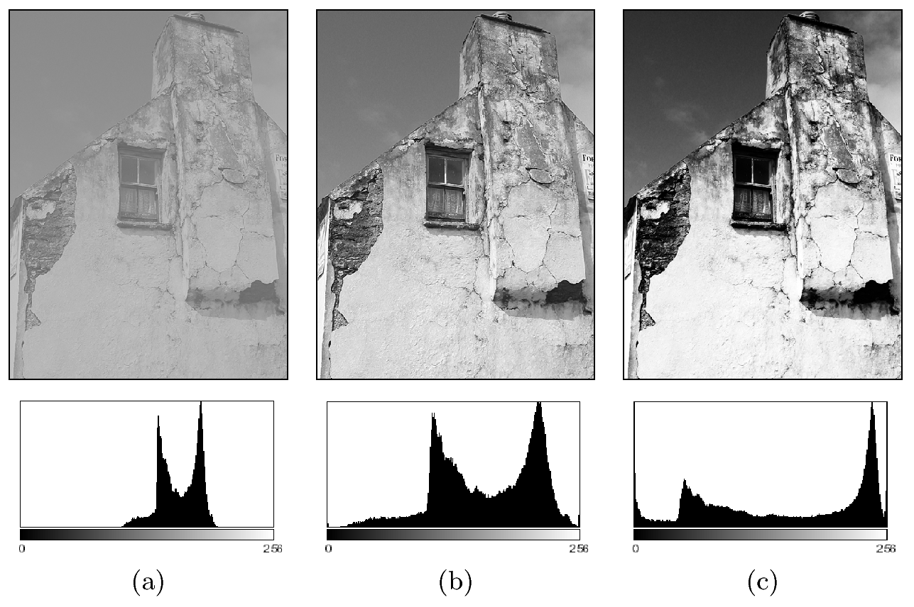
Contrast
Low
Normal
High

Slide 9
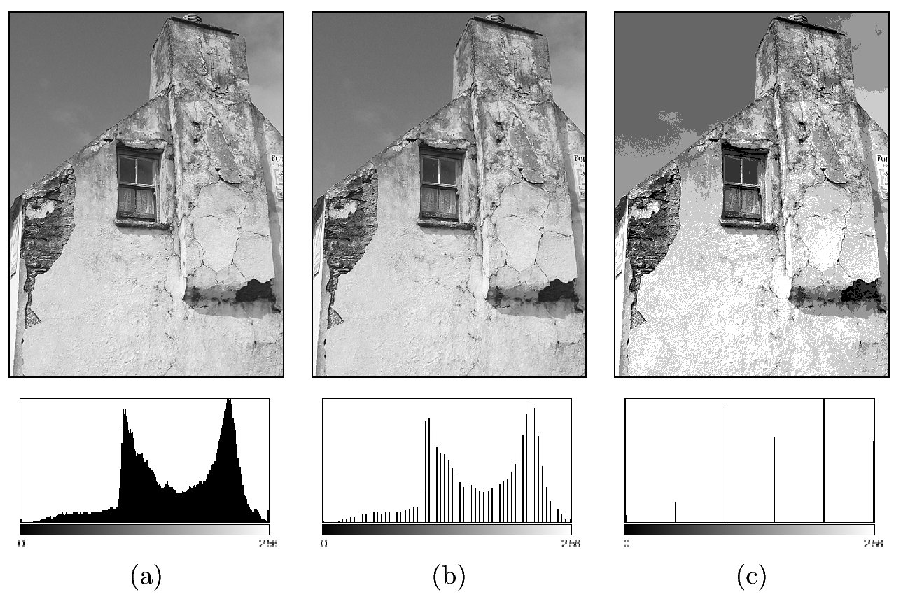
Dynamic range
High
Low
Extremely low

Slide 10
How to compute a histogram
Let’s compute histogram for a L gray level image
Initialize histogram array: h[n] = 0, n=0,…,L-1
Let height and width be the number of row and columns of image I, respectively
For i from 0 to height-1
For j from 0 to width-1
h[ I[i, j] ] += 1

Slide 11
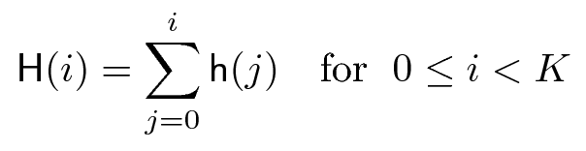
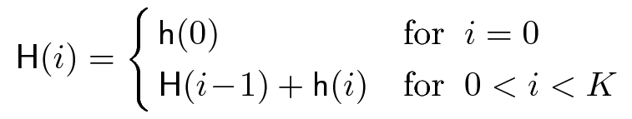
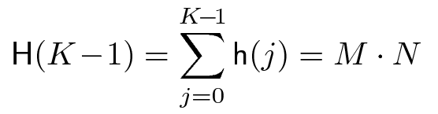
Cumulative histogram

Slide 12
Example: Cumulative histogram
8 gray level Image
3 | 0 | 1 | 2
4 | 3 | 6 | 7
3 | 2 | 1 | 4
Gray level i | 0 | 1 | 2 | 3 | 4 | 5 | 6 | 7
Histogram h[i] | 1 | 2 | 2 | 3 | 2 | 0 | 1 | 1
Cumulative histogram H[i] | 1 | 3 | 5 | 8 | 10 | 10 | 11 | 12

Slide 13
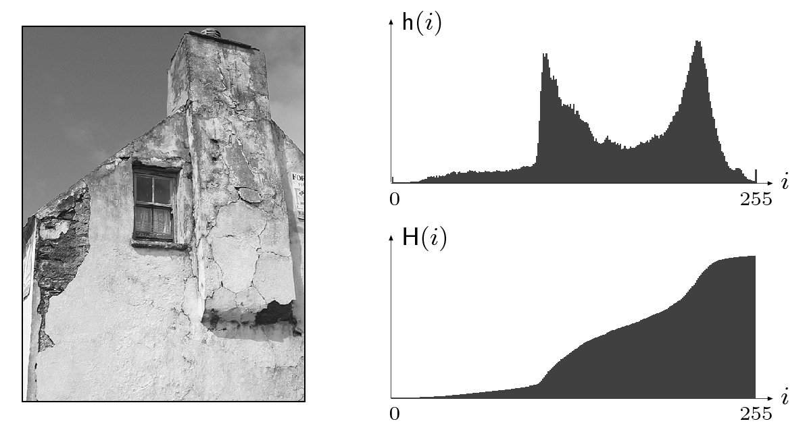
Example of cumulative histogram

Slide 14
Normalized histogram
Suppose h(i) is a histogram
It’s normalized version is defined as
One can think of the normalized histogram as a probability mass function: p(i) means the probability of a pixel value to be i

Slide 15
Normalized cumulative histogram
Suppose H(i) is a cumulative histogram
It’s normalized version is defined as: H(i)/(MN)

Slide 16
Example: Normalized histogram and normalized cumulative histogram
8 gray level Image
3 | 0 | 1 | 2
4 | 3 | 6 | 7
3 | 2 | 1 | 4
Gray level i | 0 | 1 | 2 | 3 | 4 | 5 | 6 | 7
Histogram h[i] | 1 | 2 | 2 | 3 | 2 | 0 | 1 | 1
Cumulative histogram H[i] | 1 | 3 | 5 | 8 | 10 | 10 | 11 | 12
Normalized histogram | 1/12 | 2/12 | 2/12 | 3/12 | 2/12 | 0 | 1/12 | 1/12
Normalized cumulative histogram | 1/12 | 3/12 | 5/12 | 8/12 | 10/12 | 10/12 | 11/12 | 1

Slide 17
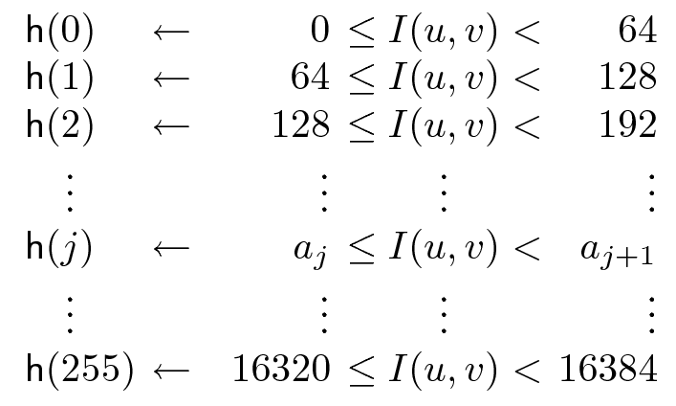
Binning for histogram
Sometimes, we need to create bins for histograms. Suppose, we have a 14 bit image.
So, the range of values is 0 to 16384. If we want to create a histogram of 256 bins, then
it would look like:
Notice that the bin widths are same.

Slide 18
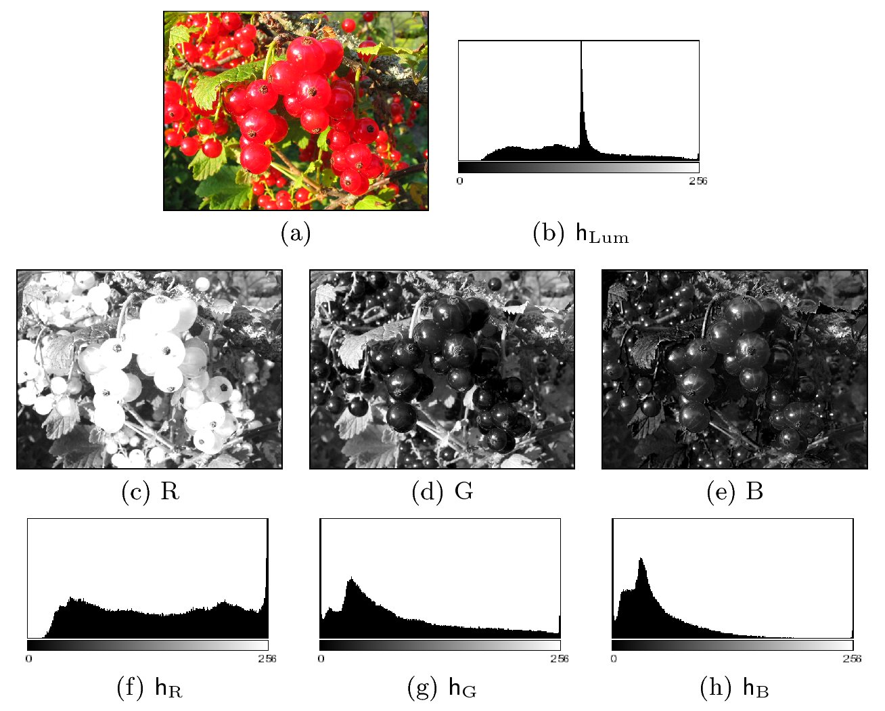
Color image histogram

Slide 19
Matching histograms and some applications
Histogram matching has many applications image processing
Image segmentation
Tracking
Content-based image retrieval
…
A quick way for content-based image retrieval can be based on histogram matching
In a database of images, find out those that have histograms similar to the histogram of a query image

Slide 20
Histogram match metrics
Before matching two histograms, they are converted into normalized histograms
Several metrics exist for matching normalized histograms
Bhattacharya coefficient
Kullback-Liebler divergence
Diffusion distance (http://www.ist.temple.edu/~hbling/publication/Ling&Okada06cvpr.pdf)
….

Slide 21
Matching two normalized histograms with Bhattacharya coefficient
Suppose two p(i) and q(i) are two normalized histograms
Bhattacharya coefficient is defined as
For a perfect match BC is 1, for a complete mismatch BC is 0
A higher BC value implies a better match

Slide 22
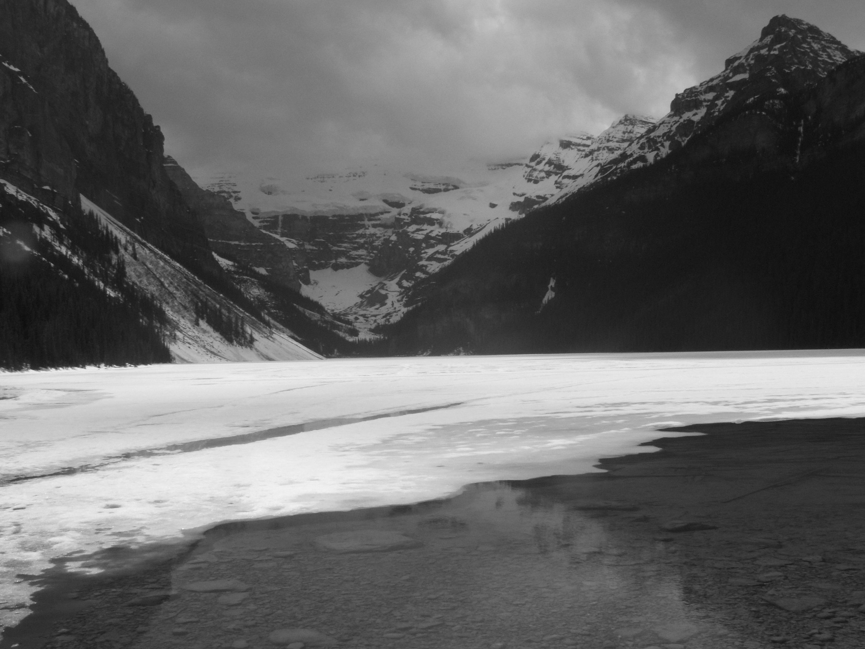


Bhattacharya coefficient: Examples
0.9161
0.9802
Notice that BC value is higher for the similar pair of images

Slide 23
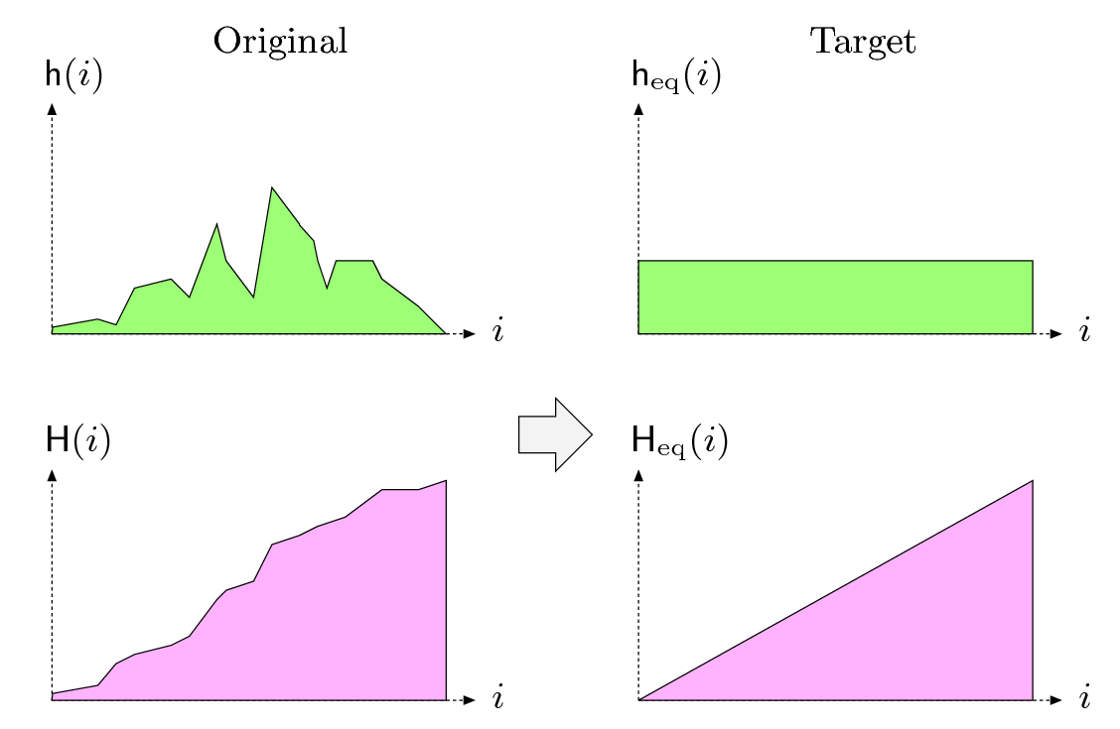
Histogram equalization
Also known as “histogram flattening”
histograms
Cumulative
histograms

Slide 24
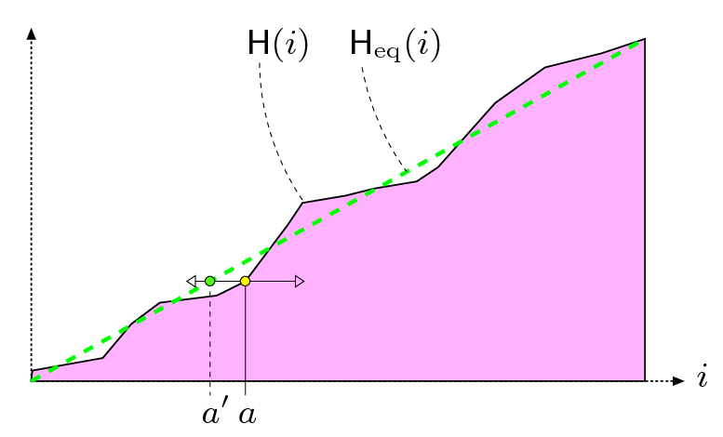
Histogram equalization…
Cumulative
histograms
Can we derive this formula?

Slide 25
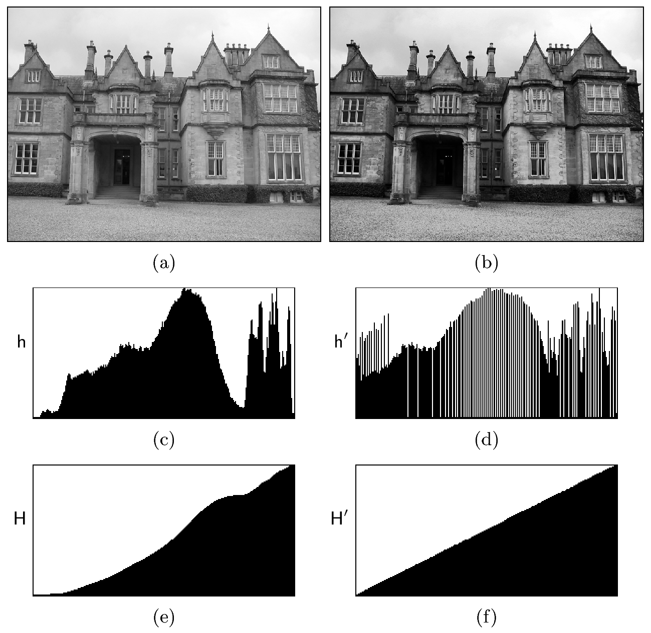
Histogram equalization: example
Original image
The image after
histograms equalization
histograms
Cumulative
histograms

Slide 26

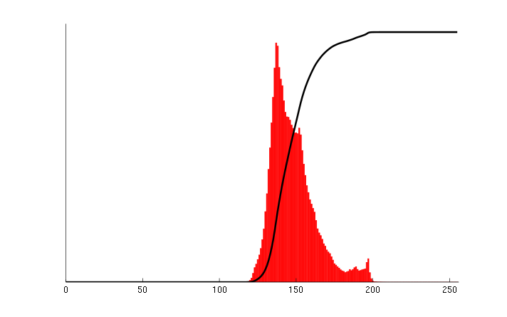
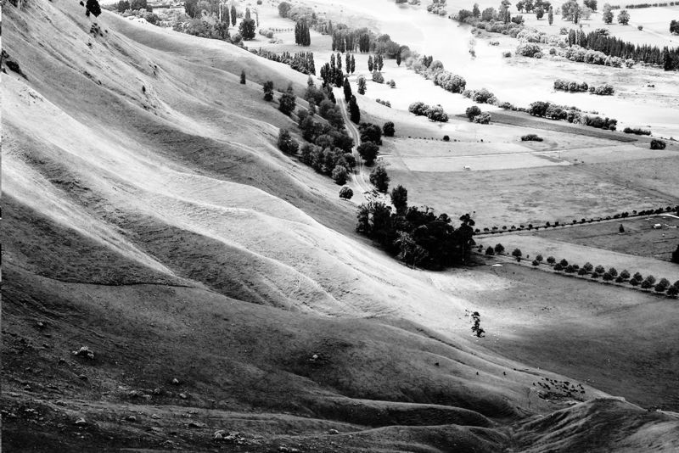
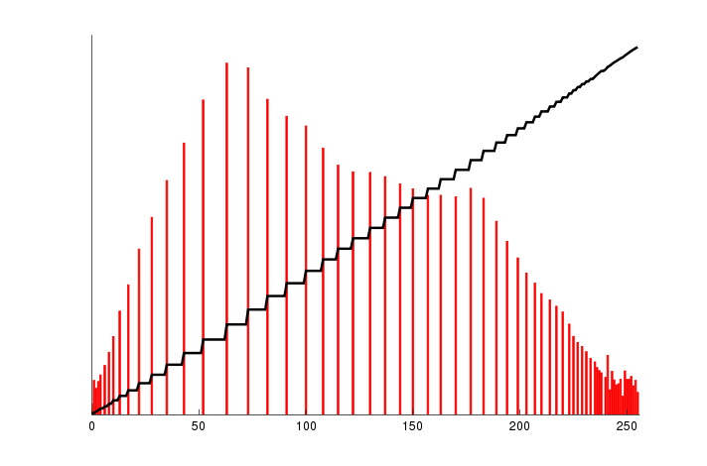
A histogram equalization example from Wikipedia
Original
image
After
histogram
equalization
Histograms (red) and cumulative
histograms (black)

Slide 27
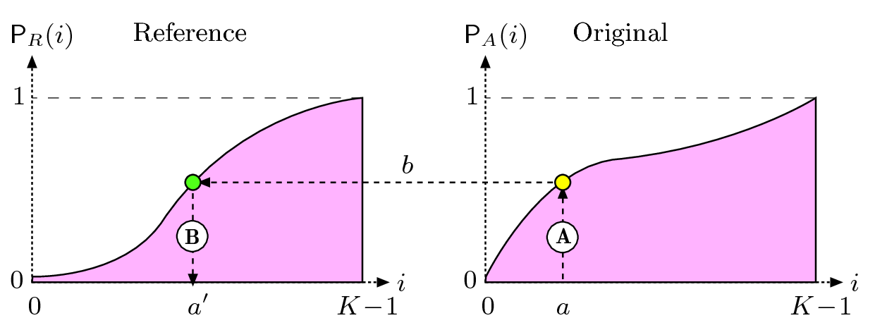
Histogram specification/shaping
P_{A} and P_{R}
are normalized
cumulative
histograms
Pictorially:

Slide 28
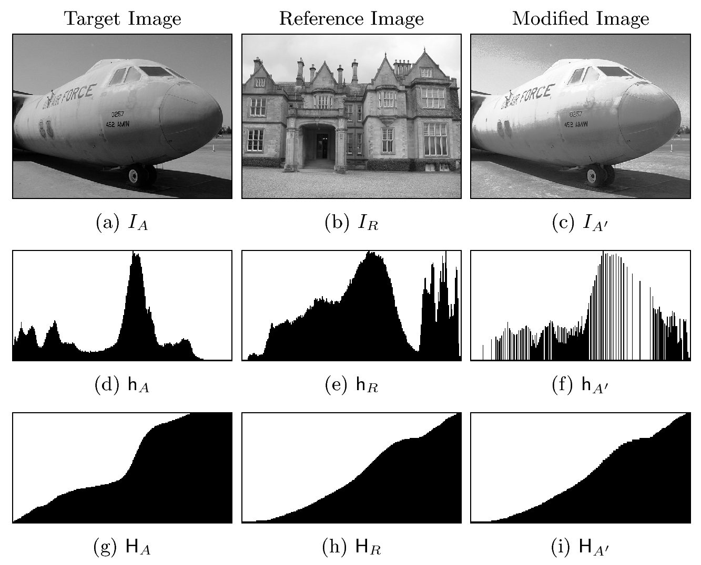
Histogram specification: example

Slide 29
Local (Adaptive) histogram equalization
Histogram equalization does not work well when the distribution of pixel values varies a lot over local windows in an image.
So, doing histogram equalization within a sliding window is often more useful than the global histogram equalization.
By the way, what is a sliding window?

Slide 30
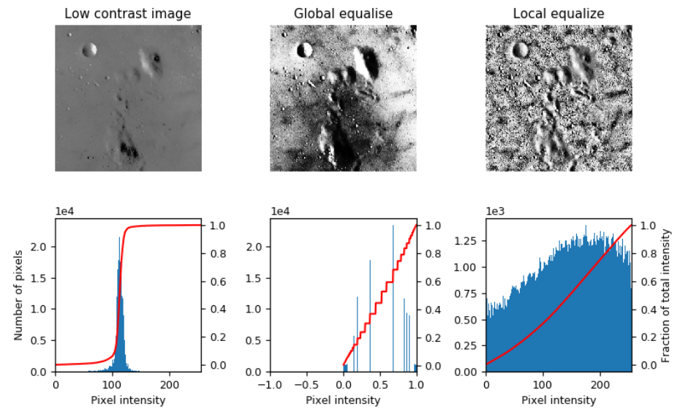
Local histogram equalization: example
http://scikit-image.org/docs/dev/auto_examples/color_exposure/plot_local_equalize.html

Slide 31
Derivation of histogram shaping
Let’s settle on some symbols first.
p_{A}(a): Normalized histogram of input image
p_{R}(a’): Normalized reference (i.e., output) histogram
a’ = f(a): Transformation function we are trying to figure out
P_{A}(a): Normalized cumulative histogram of input image
P_{R}(a’): Normalized cumulative reference (i.e., output) histogram
Let’s take note of the following two identities:
P_{A}⁽¹⁾(a) = p_{A}(a): First derivative of input normalized cumulative histogram = normalized input histogram
P_{R}⁽¹⁾(a’) = p_{R}(a’): First derivative of reference (i.e., output) normalized cumulative histogram = normalized reference (i.e., output) histogram
This is an advanced and optional topic: not included in your CMPUT 206 syllabus.

Slide 32
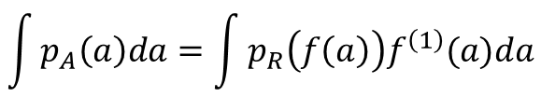
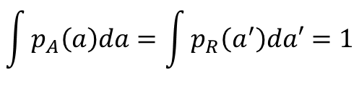
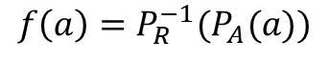
Derivation of histogram shaping…
Let’s start with the following identity:
$$\int{p_{A}\left(a\right)da}=\int{p_{R}\left(a^{′}\right)da′}=1$$
If we substitute a’ = f(a) in the above identity, we obtain:
$$\int{p_{A}\left(a\right)da}=\int{p_{R}\left(f\left(a\right)\right)f^{\left(1\right)}(a)da}$$
Claim is that the following transformation function satisfies the above identity:
$$f\left(a\right)=P_{R}^{−1}(P_{A}(a))$$

Slide 33
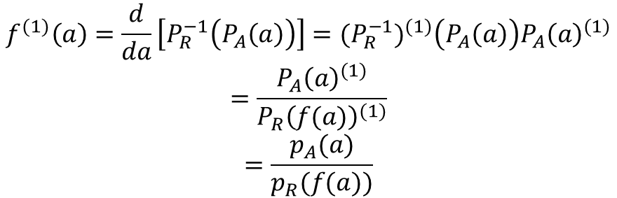
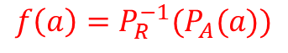
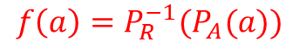
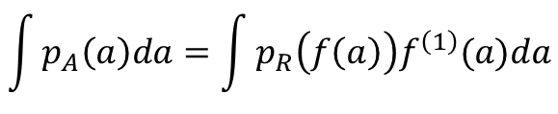
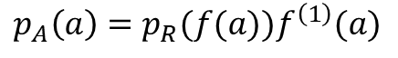
Derivation of histogram shaping…
$$f\left(a\right)=P_{R}^{−1}(P_{A}(a))$$
Differentiate both sides of the above equation to obtain:
$$f^{(1)}\left(a\right)=\frac{d}{da}\left[P_{R}^{−1}\left(P_{A}\left(a\right)\right)\right]={(P_{R}^{−1})}^{(1)}\left(P_{A}\left(a\right)\right){P_{A}\left(a\right)}^{(1)}$$
$$=\frac{{P_{A}\left(a\right)}^{(1)}}{{P_{R}\left(f(a)\right)}^{(1)}}$$
$$=\frac{p_{A}(a)}{p_{R}(f(a))}$$
Chain rule of derivative
Derivative of an inverse function = reciprocal of derivative of the function
Use two identities noted before
So, we obtain the result:
$$p_{A}\left(a\right)=p_{R}(f(a))f^{\left(1\right)}(a)$$
$$\int{p_{A}\left(a\right)da}=\int{p_{R}\left(f\left(a\right)\right)f^{\left(1\right)}(a)da}$$
This result satisfies the identity:
Thus, our claim is true.
$$f\left(a\right)=P_{R}^{−1}(P_{A}(a))$$

